Slide 1
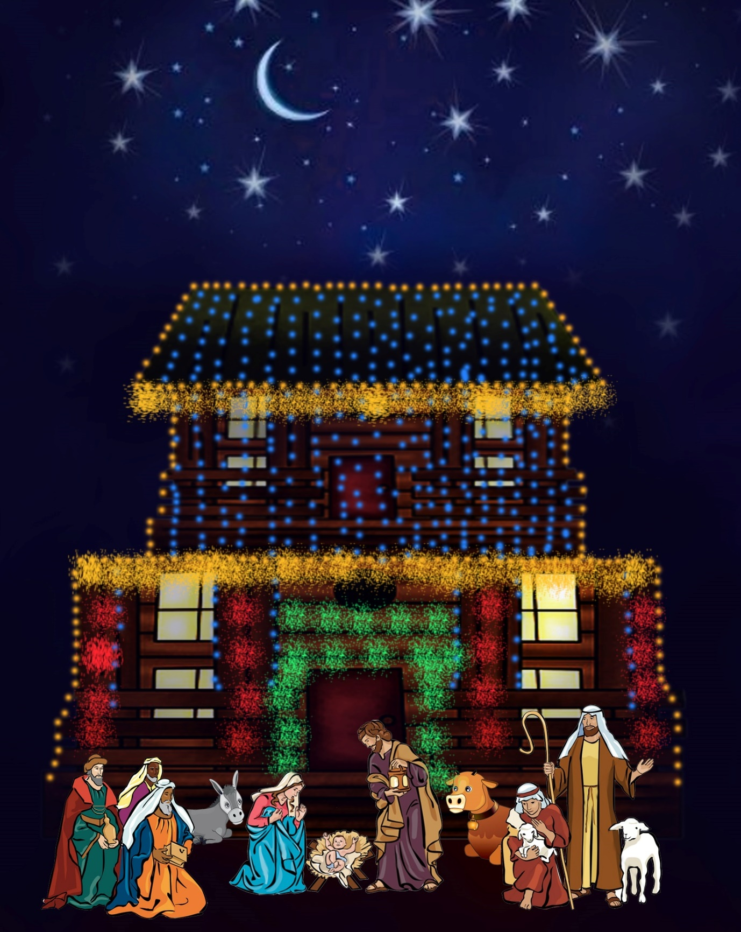

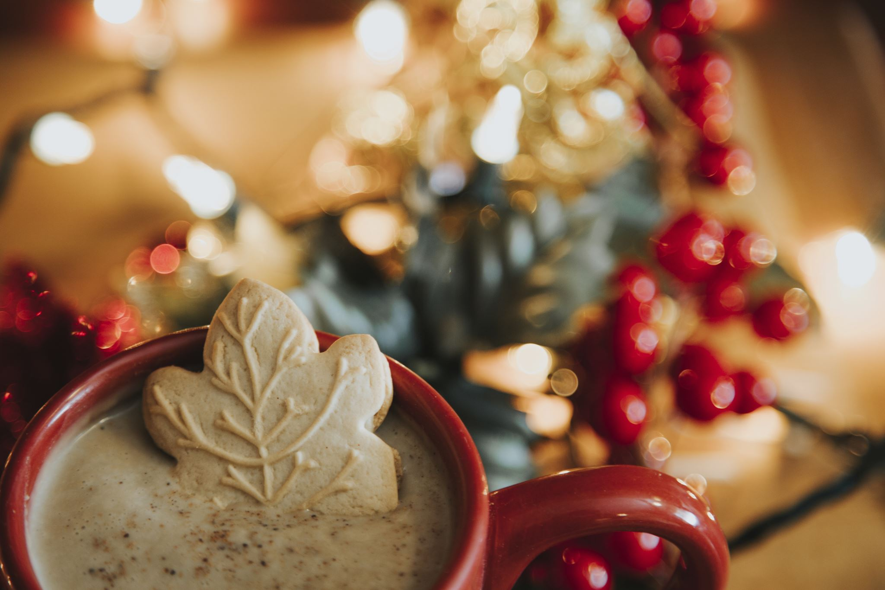


Tween Holiday Issue 5
Christmas time!
Celebrating
The Nativity!
@tweenholiday
© 2020, Sapphire Group Media Publishing.

Slide 2
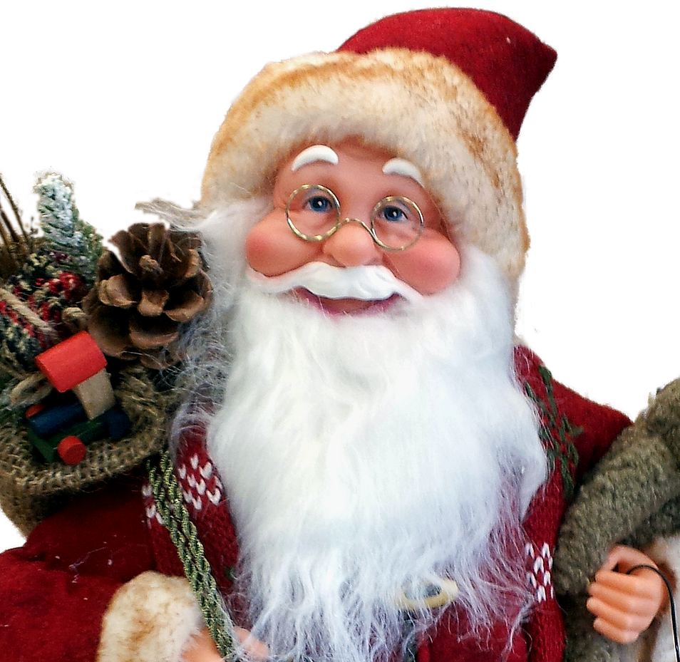
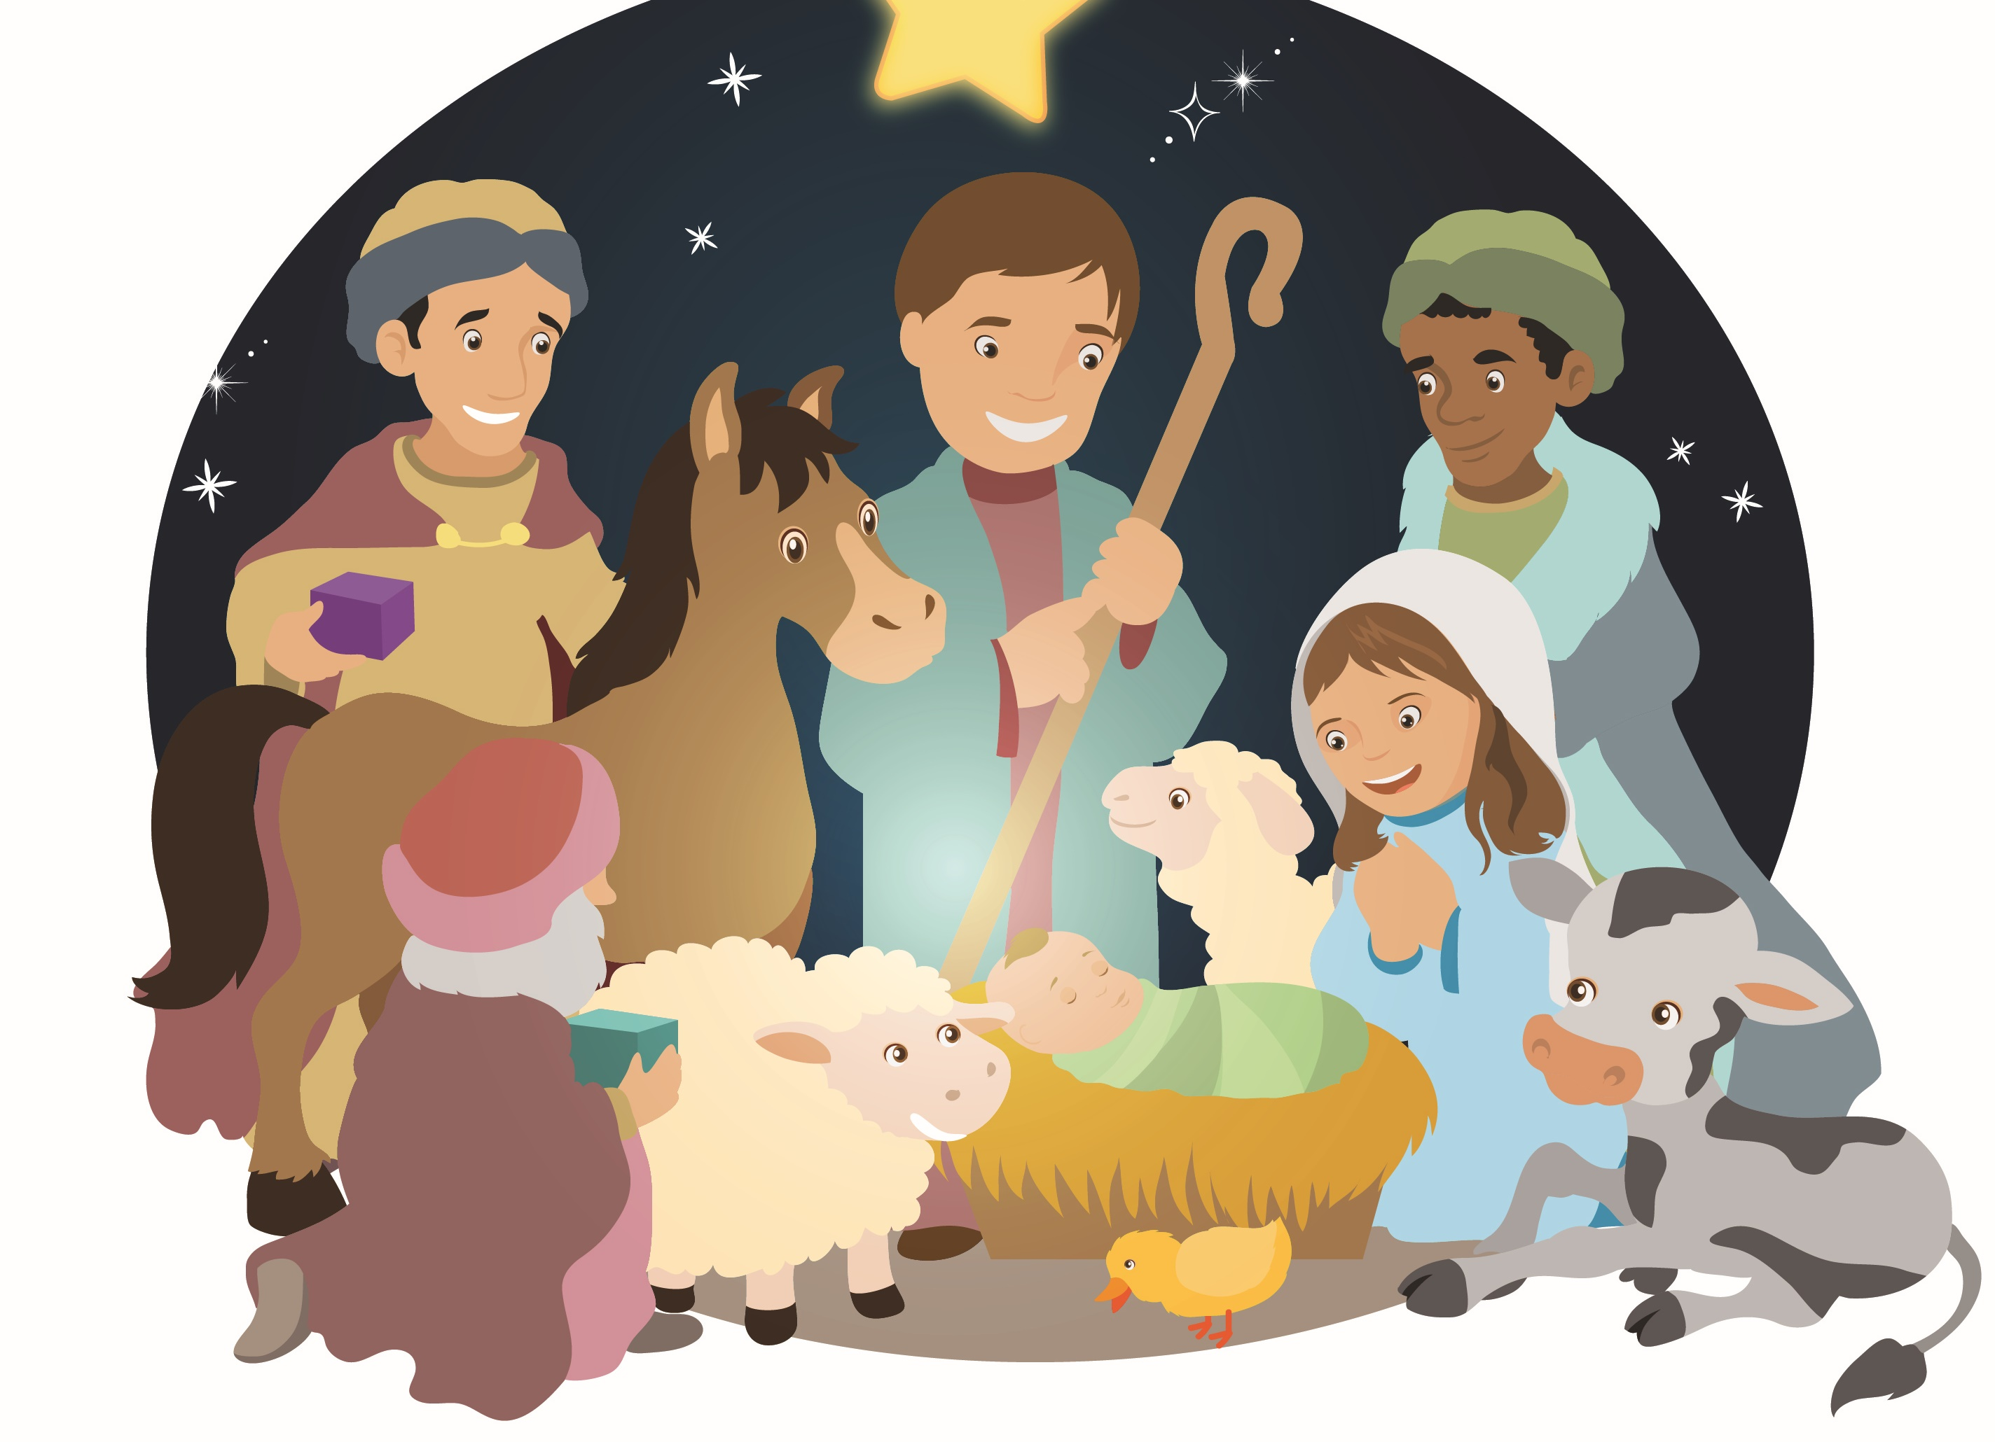

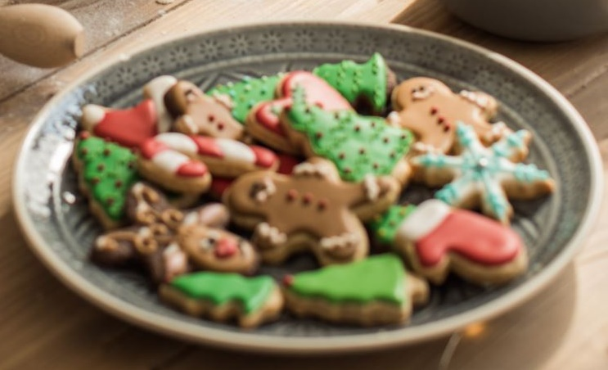

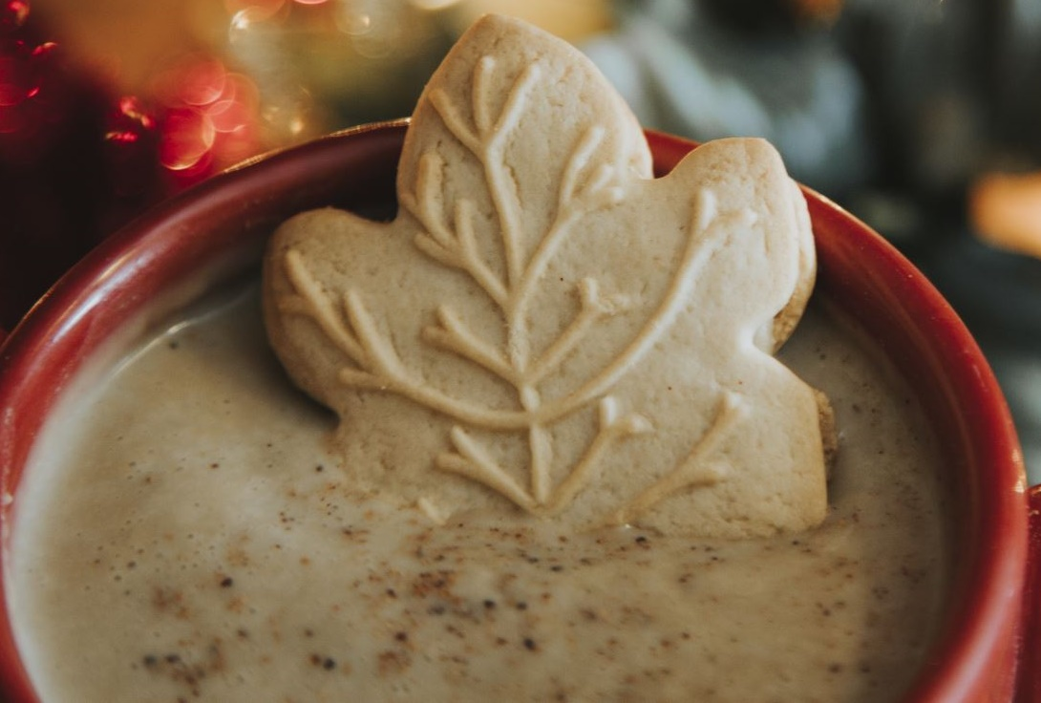
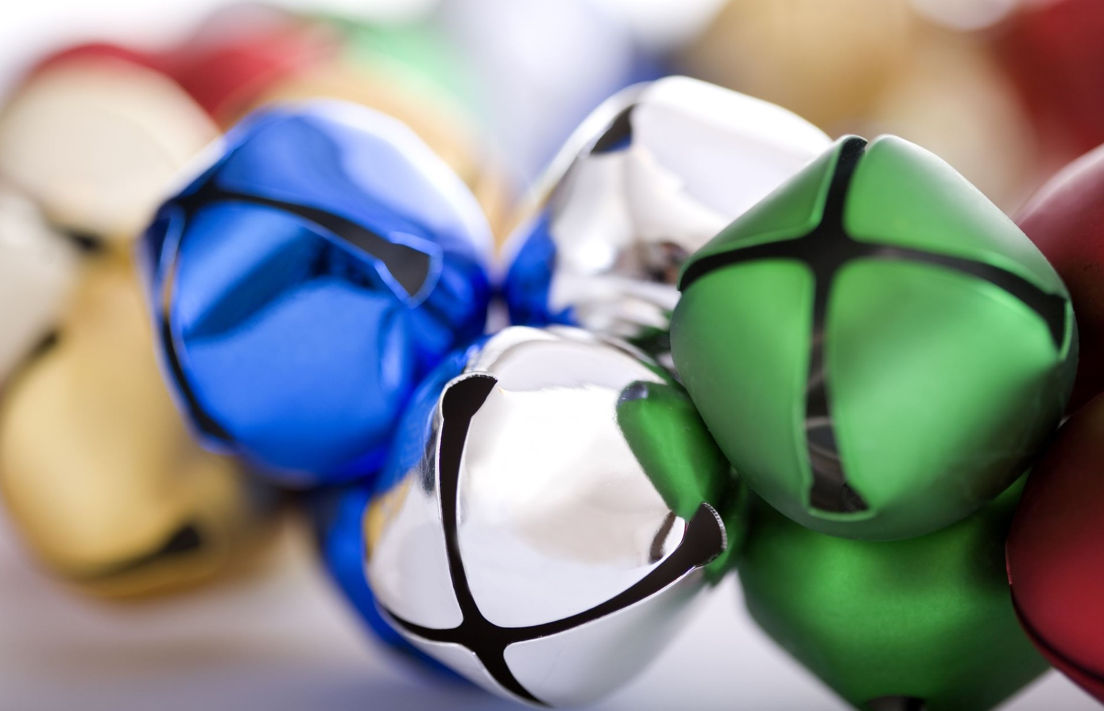
Celebrating
The Nativity!
Hey everyone,
Hope you enjoy this issue of Tween Holiday!
We are so excited for this Christmas issue! And look forward to sharing the New Year issue with you in January 2021!
In the meantime, Merry Christmas and Happy New Year.
Take time to chill, relax and enjoy good food, family and fun this season.
Caritas, from the TH Crew.
Tween Holiday
CHRISTIMAS TIME #5
In this issue
The Legend of Santa
That First Christmas
Christmas cookies
Gift wrapping
Writers
Cam Cam & Zizi
Editorial Review
Anton
Editor In Chief
Linda Unugboke
Creative Directors
Cam Cam & Linda
Christmas drinks
Favourite carols
@tweenholiday
© 2020, Sapphire Group Media Publishing.

Slide 3

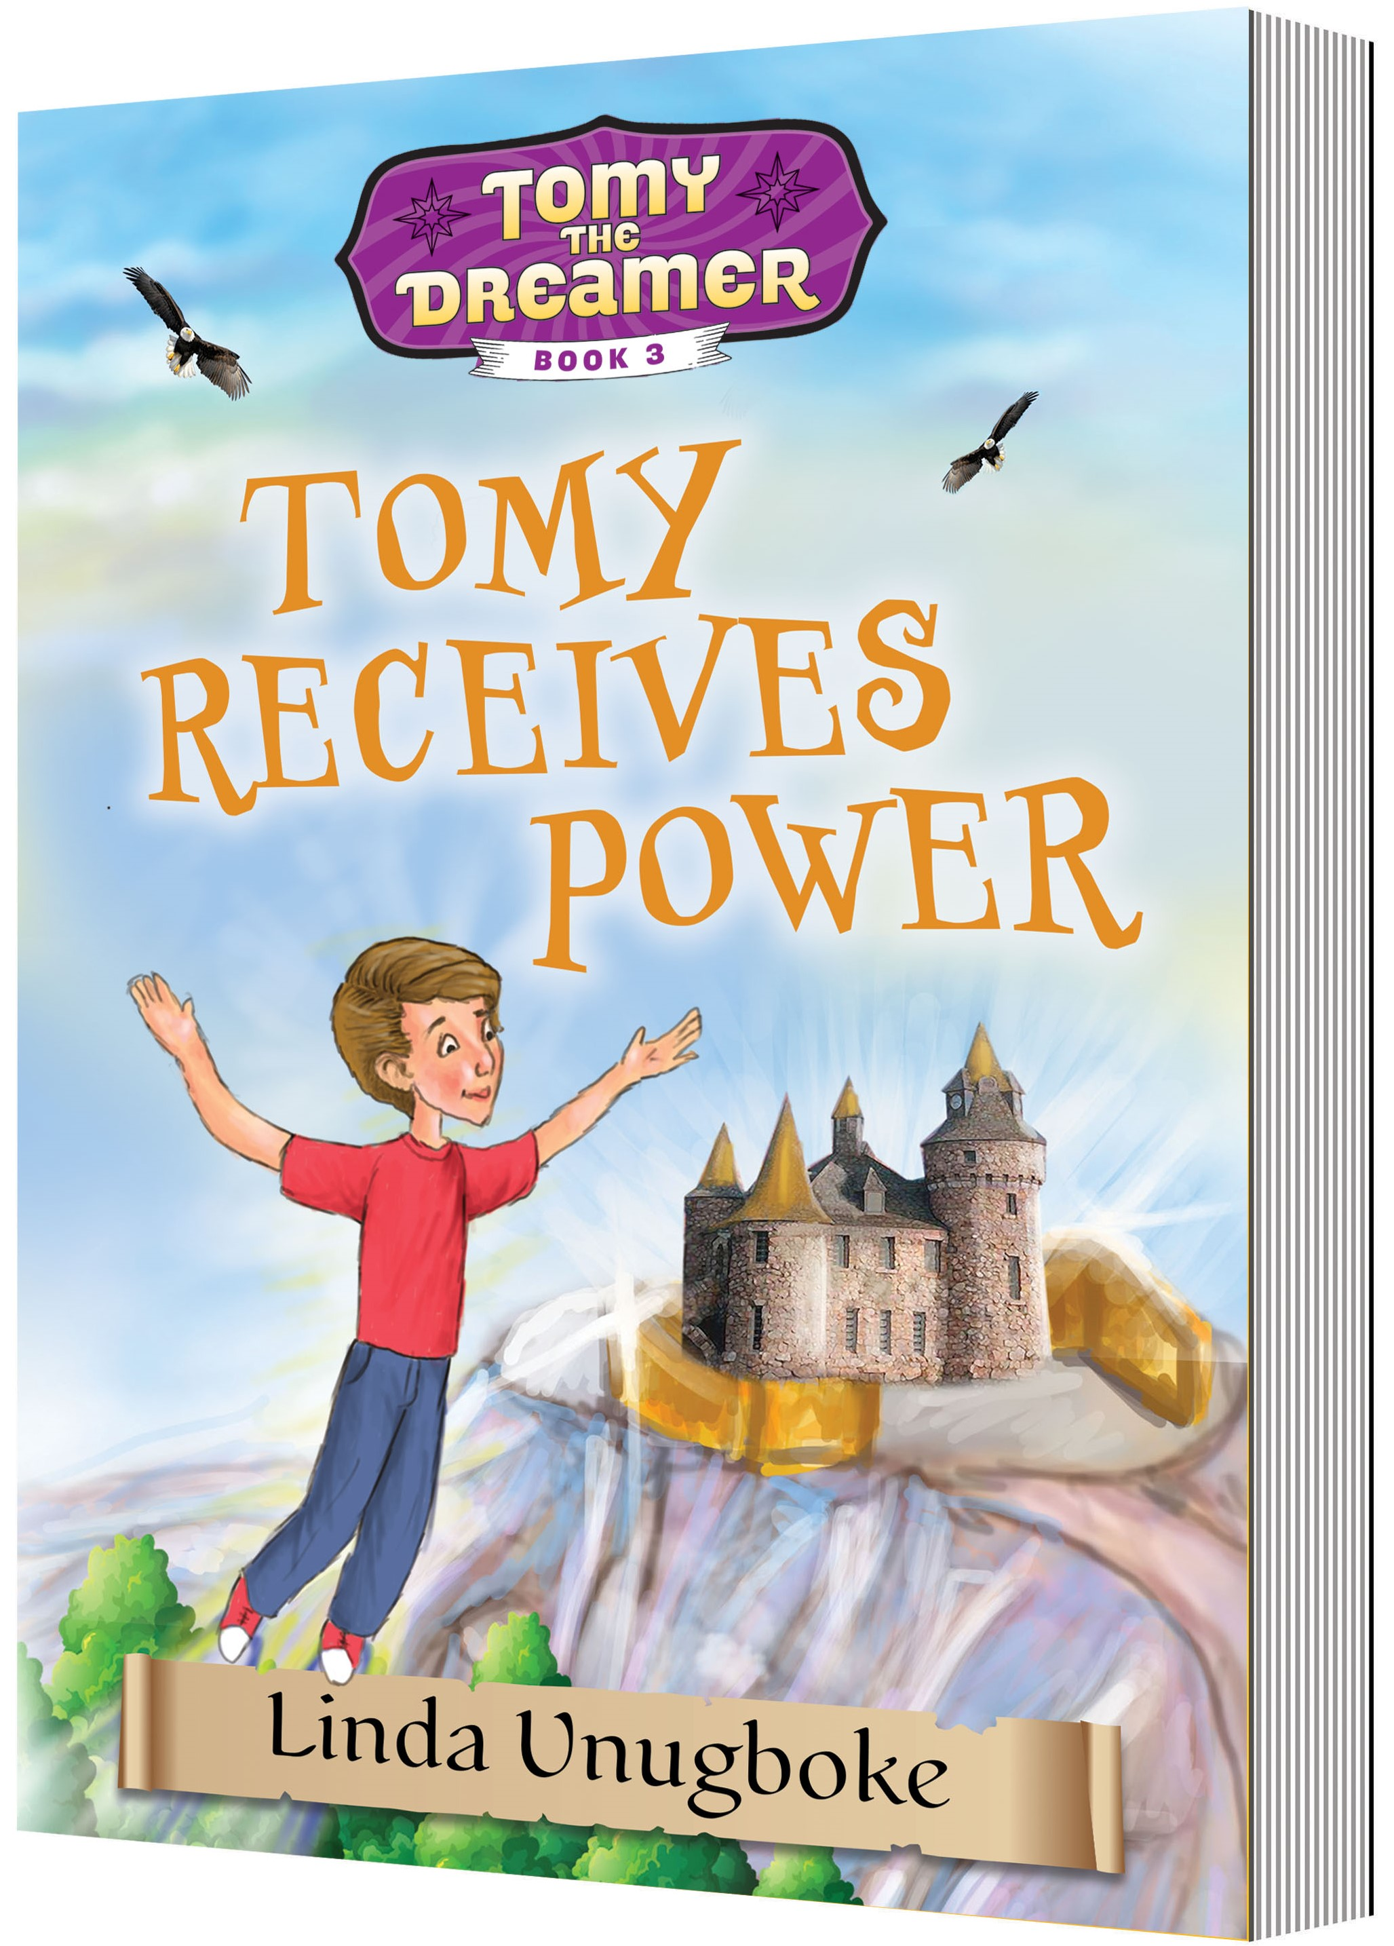
We come bearing gifts
A new book release by our Editor – in – chief
We’re delighted to introduce Tomy Receives Power, this is book 3 in Tomy the Dreamer series. Visit www.tomythedreamer.com
This book packed full of wondrous adventure of Tomy and his friends as they discover some amazing new powers for a special mission. It’s for sure one of our favourite books! For real! ☺
We invite you to grab a copy from Amazon and enjoy a lovely holiday season read!
Leave a review
to let us know
how much you’ve
enjoyed it too!
Christmas is here and we know you will be wrapping up some presents.
Gift tags are always in use at this time of the year.
So to make some cool ones, check out this website => Arty DIY Gift Tags | The Craft Train

Slide 4
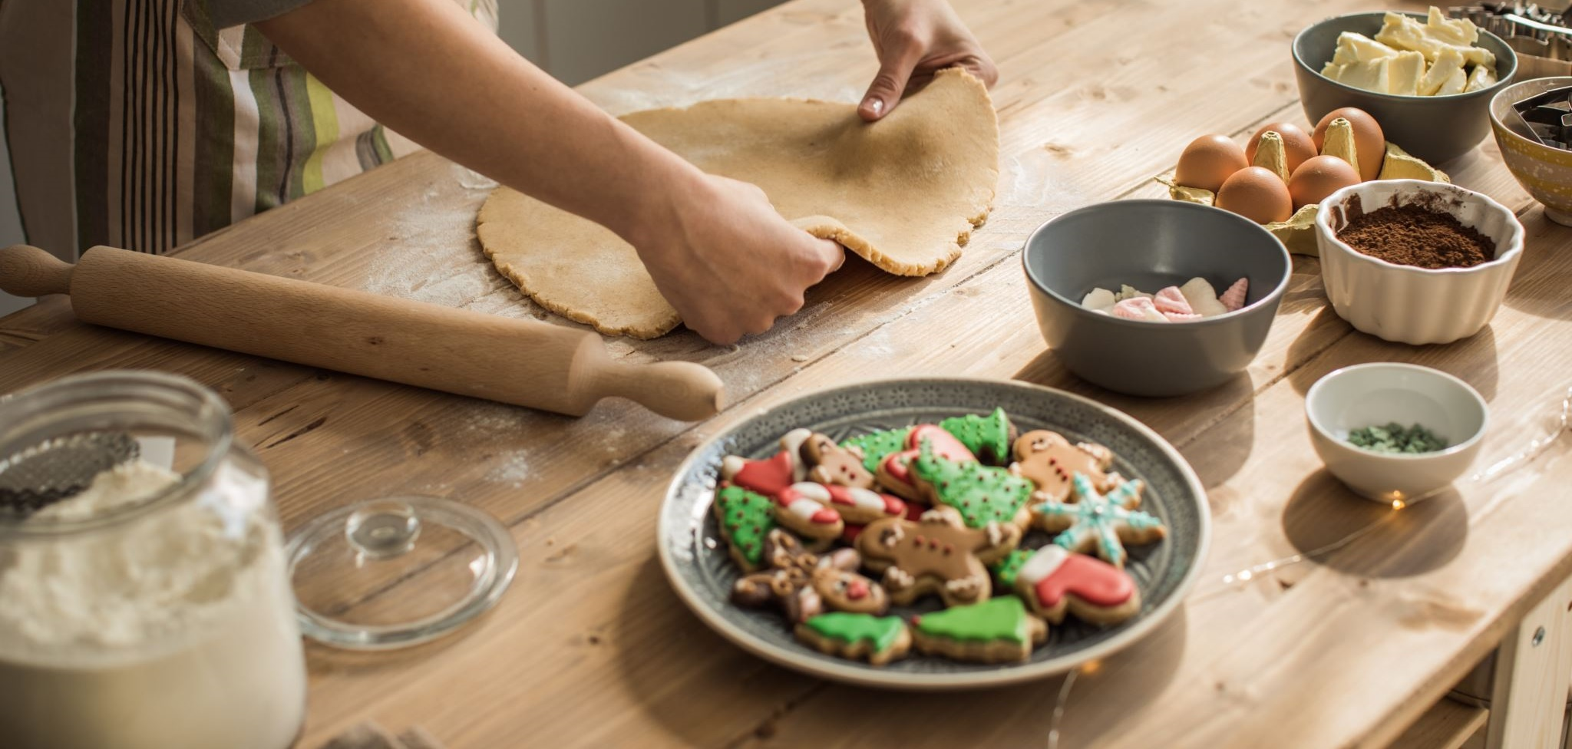
Everyone likes a bit of Christmas cooking! Well lucky for you because we have some delicious recipes like:
How to make candy cane cookies
Ingredients:
180g butter (softened)
1 cup caster sugar
1 egg
2 tsp peppermint essence
1 tsp vanilla extract
2 1/4 cups plain flour
2 tsp red food colouring (liquid)
Method:
Get a mixer and cream the butter and sugar together.
Add the egg, peppermint essence and vanilla extract.
Add the flour a little at a time until well combined. Remove half of the mixture and set aside. Add the red food colouring to the remaining dough and mix well.
Preheat oven to 180°C fan setting. Line a baking tray with baking paper.
Gather the dough and roll 8cm lengths of each colour and twist into candy cane shapes
Bake for 8-10 minutes until candy canes are lightly brown. Leave to cool on the tray.
Tie with Christmas ribbon.
If you would like any more recipes, here is a website Christmas candy cane cookies recipe - Kidspot
Christmas Cookies

Slide 5
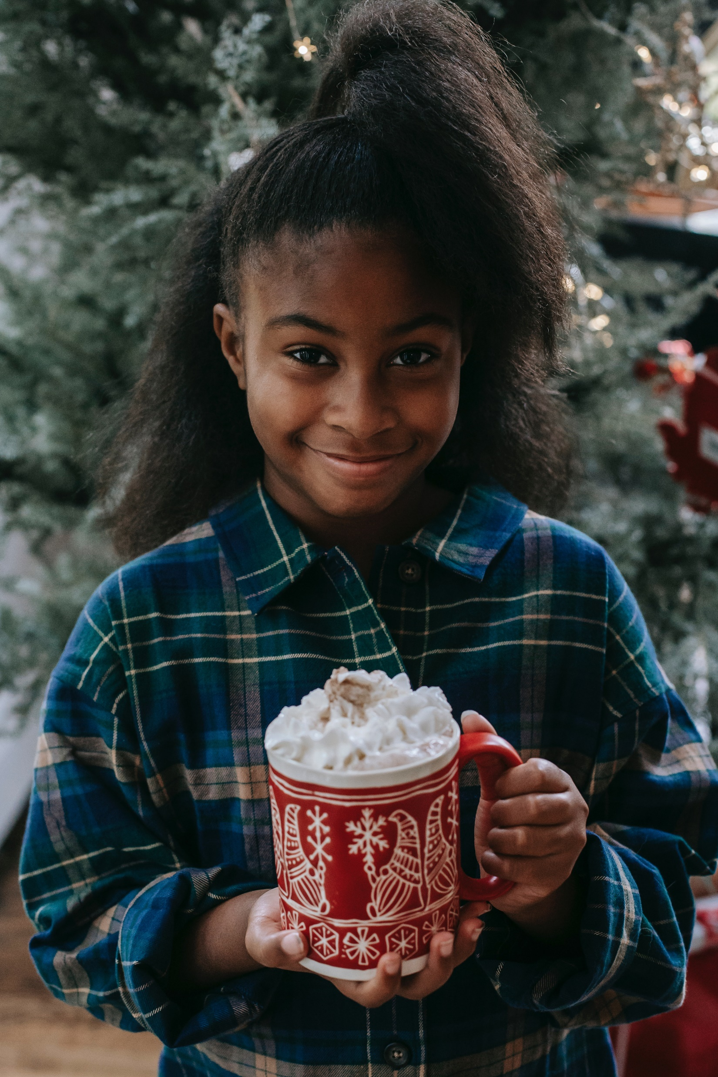
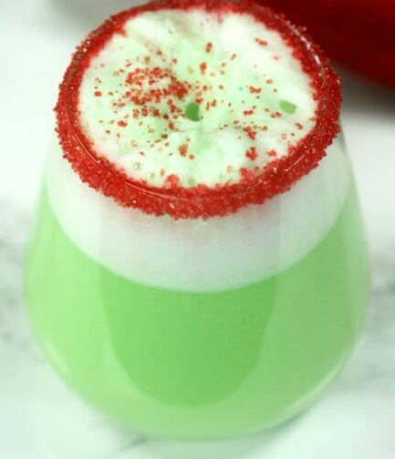
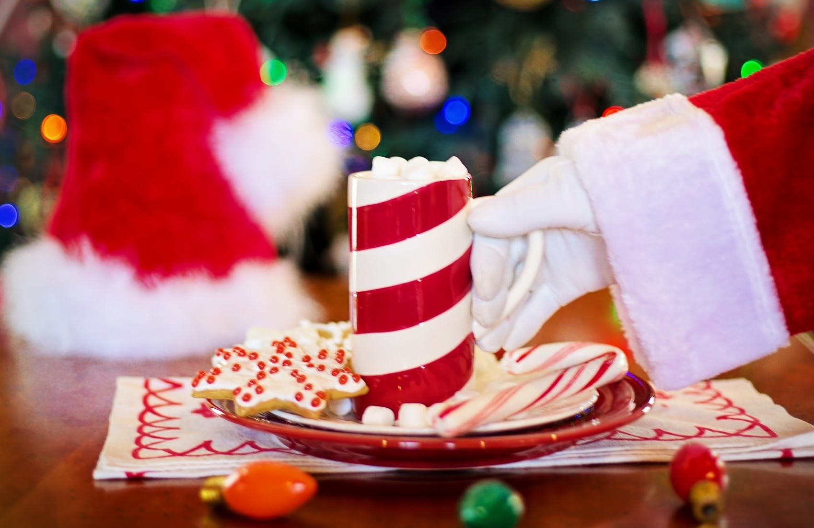
It is getting colder and the days are getting shorter. Christmas is around the corner and something that I especially like are
Christmas drinks.
There might not be many.
That is why we are making a list of them for you to try.
Hope you enjoy😀
Christmas Drinks
Mint hot chocolate is always a nice choice.
What about a Christmas slush as they are refreshing?
Candy cane white hot chocolate.
And last but not least the Grinch punch.
© 2020, Sapphire Group Media Publishing.

Slide 6
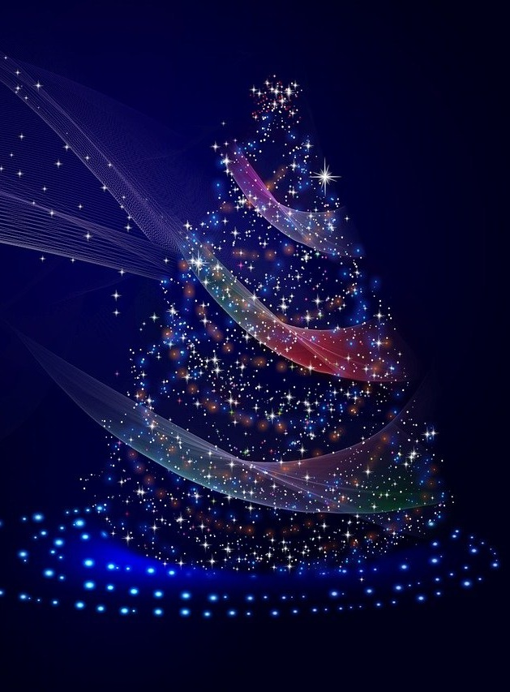
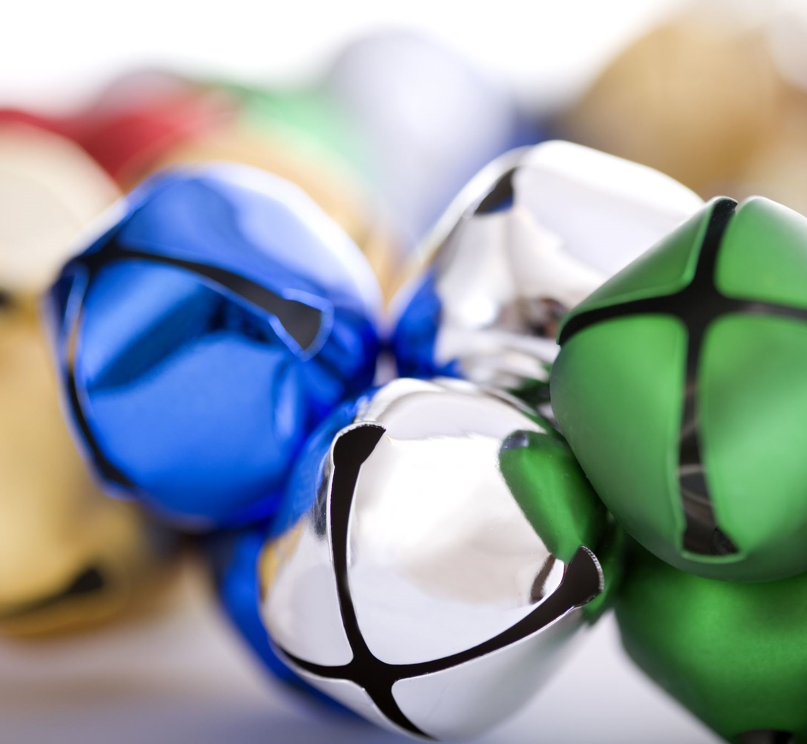
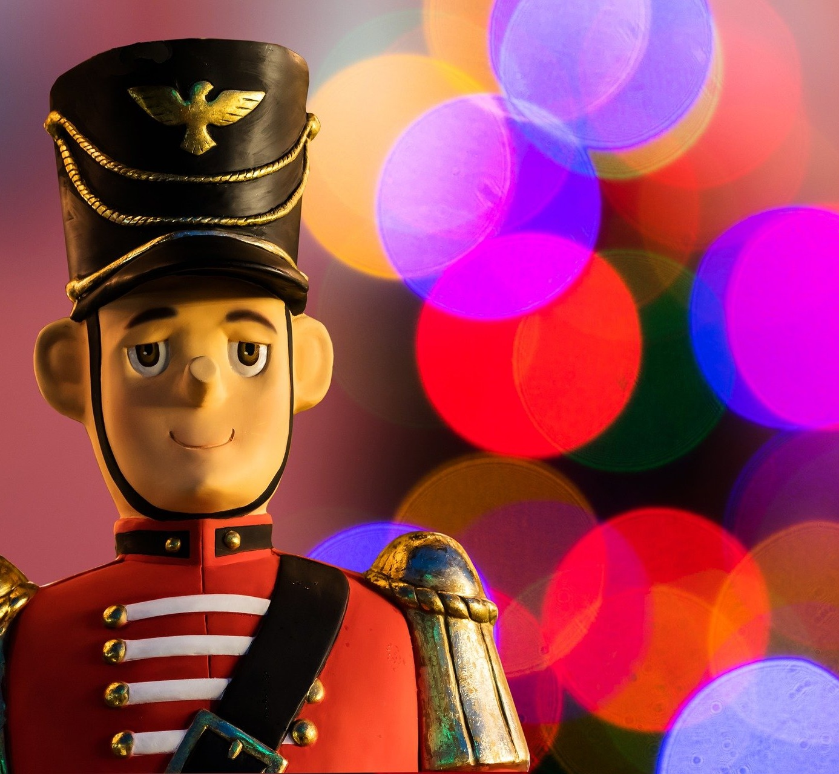
Carols
Oh, holy night! The stars are brightly shining
It is the night of the dear Savior's birth
Long lay the world in sin and error pining
Till He appeared and the soul felt its worth
A thrill of hope the weary world rejoices
For yonder breaks a new and glorious morn
Fall on your knees! Oh, hear the angel voices
Oh, night divine
Oh, night when Christ was born
To lay before the King pa-rum pum pum pum
Rum pum pum pum. rum pum pum pum
So to honor Him pa-rum pum pum pum
When we come
Oh, Holy Night!
Jingle Bells
Jingle bells, Jingle bells, Jingle all the way
Oh what fun it is to ride in a one-horse open sleigh
Jingle bells, Jingle bells, Jingle all the way
Oh what fun it is to ride in a one-horse open sleigh
Our favourite timeless classics
Drummer Boy by Boney M is a hit!
Come, they told me pa-rum pum pum pum
Our newborn King to see, pa-rum pum pum pum
Our finest gifts we bring pa-rum pum pum pum

Slide 7
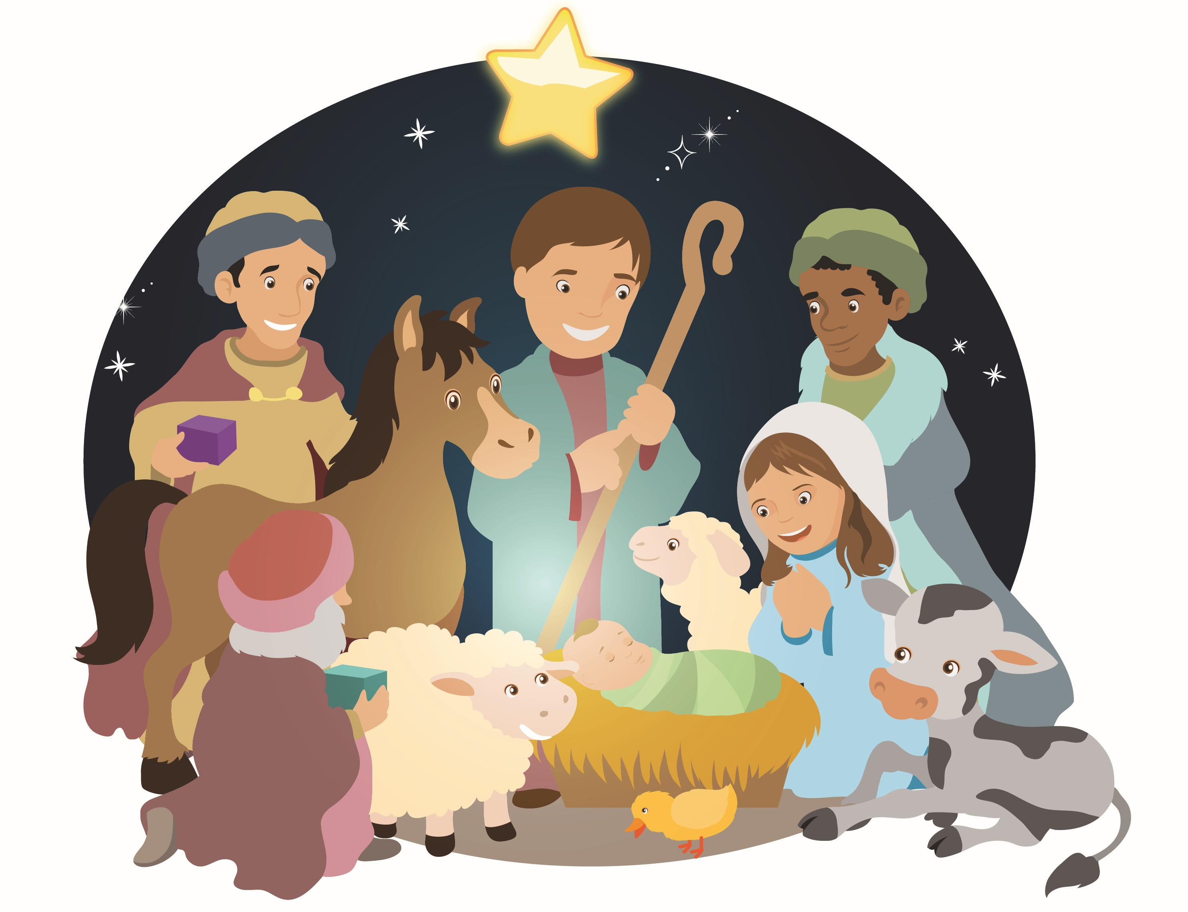
That first Christmas
Away in a manger
No crib for His bed
The little Lord Jesus
Lay down His sweet head
The stars in the sky
Look down where He lay
The little Lord Jesus
Asleep on the hay
The cattle are lowing
The Baby awakes
But little Lord Jesus
No crying He makes
I love Thee, Lord Jesus
Look down from the sky
And stay by my side
'Til morning is nigh
© 2020, Sapphire Group Media Publishing.

Slide 8
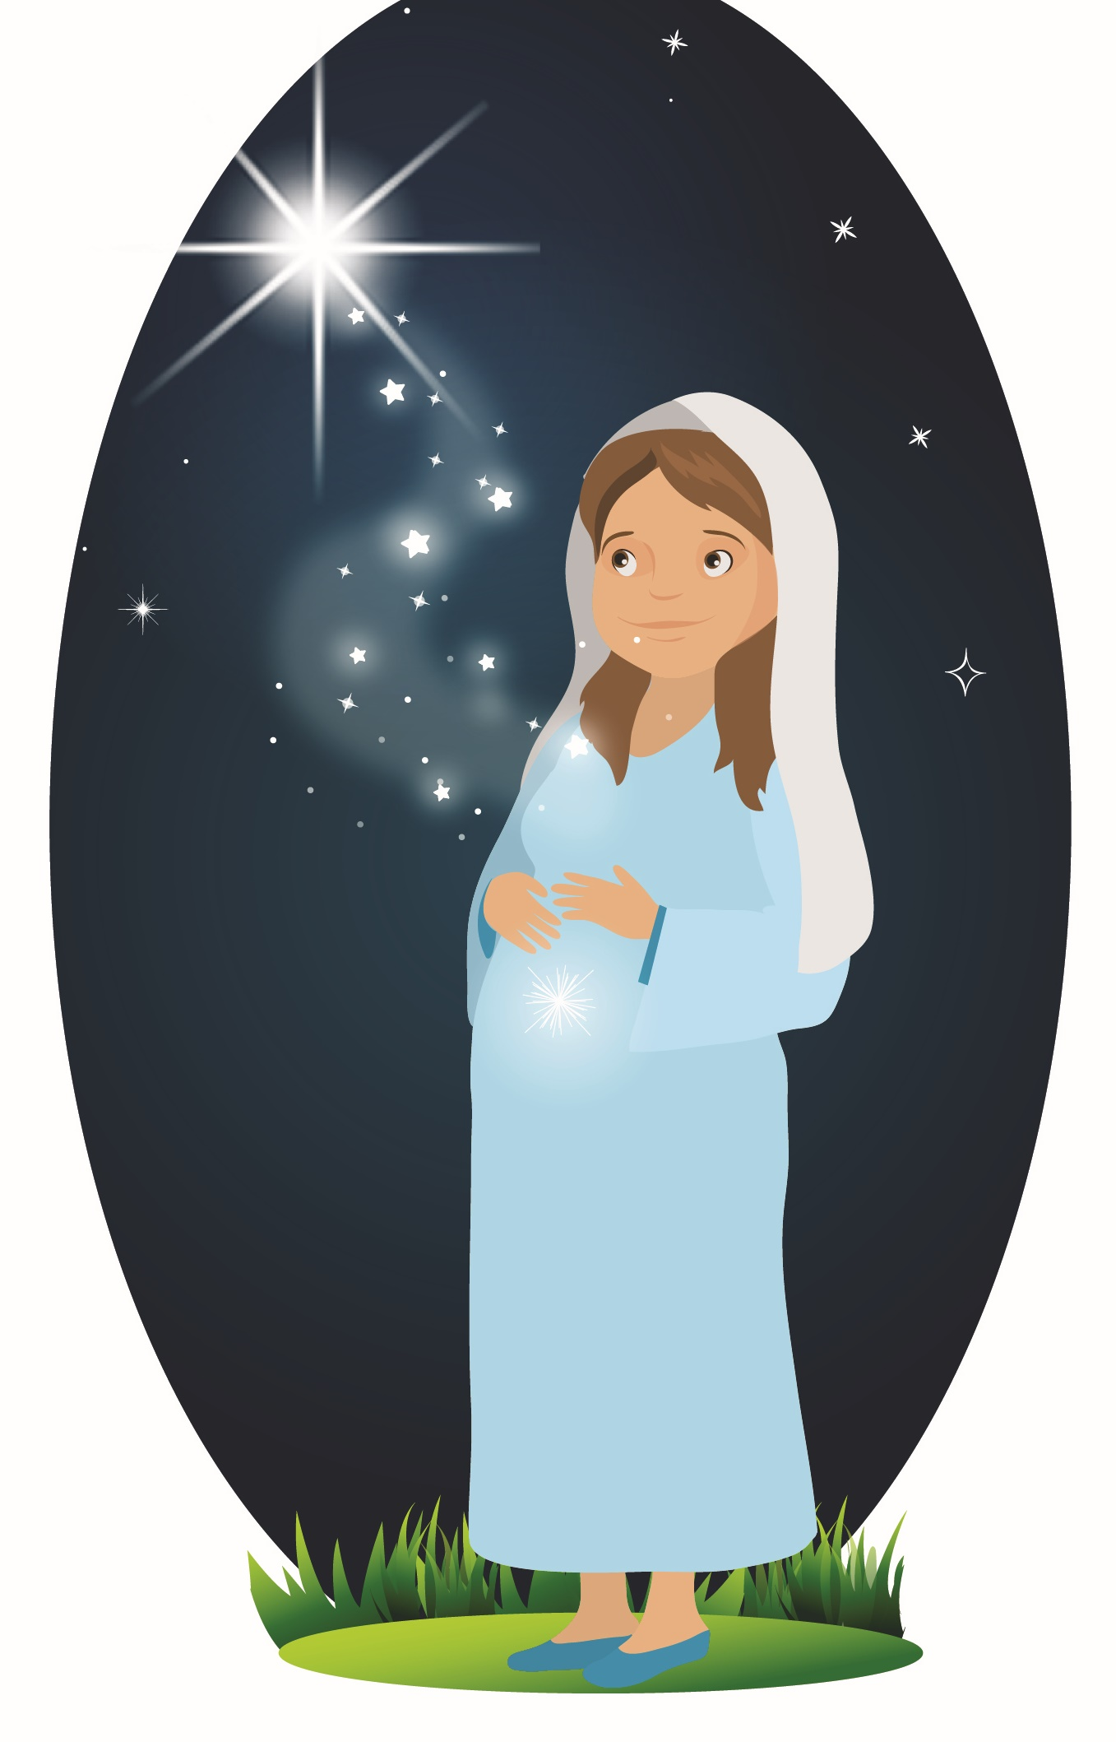
The Story of the Nativity
One night, shortly after, a man named Joseph who was to marry Mary had a dream about an angel telling him that Mary was to give birth to Jesus.
A few months later, a census was taking place, so everyone had to travel to their hometown to be registered.
Mary and Joseph travelled back to their hometown in Bethlehem. Mary was soon to have the baby, so they were looking for an Inn to stay in. But there was no room in any of the inns. When they knocked on the door of the last innkeeper, he said, “I’m sorry but there’s no room. It may not be much, but would you like to stay in the stable behind my Inn?”
The story of the Nativity is how Christmas began.
It started with a girl named Mary.
An angel called Gabriel, sent by God came to Mary and said, “Mary, you shall bear a son and He will be the son of God and you shall name Him Jesus”.
Mary said “yes” to the angel’s message and accepted to become the mother of Jesus.
© 2020, Sapphire Group Media Publishing.

Slide 9
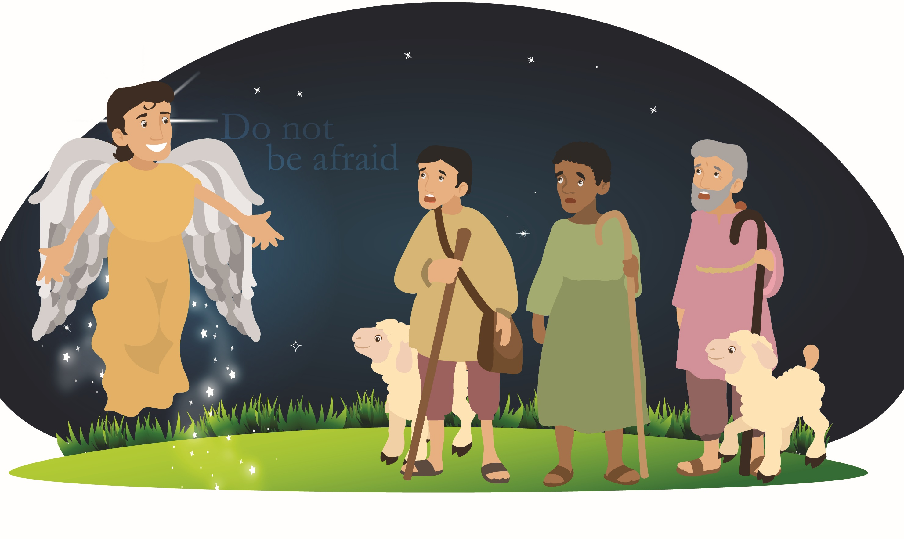
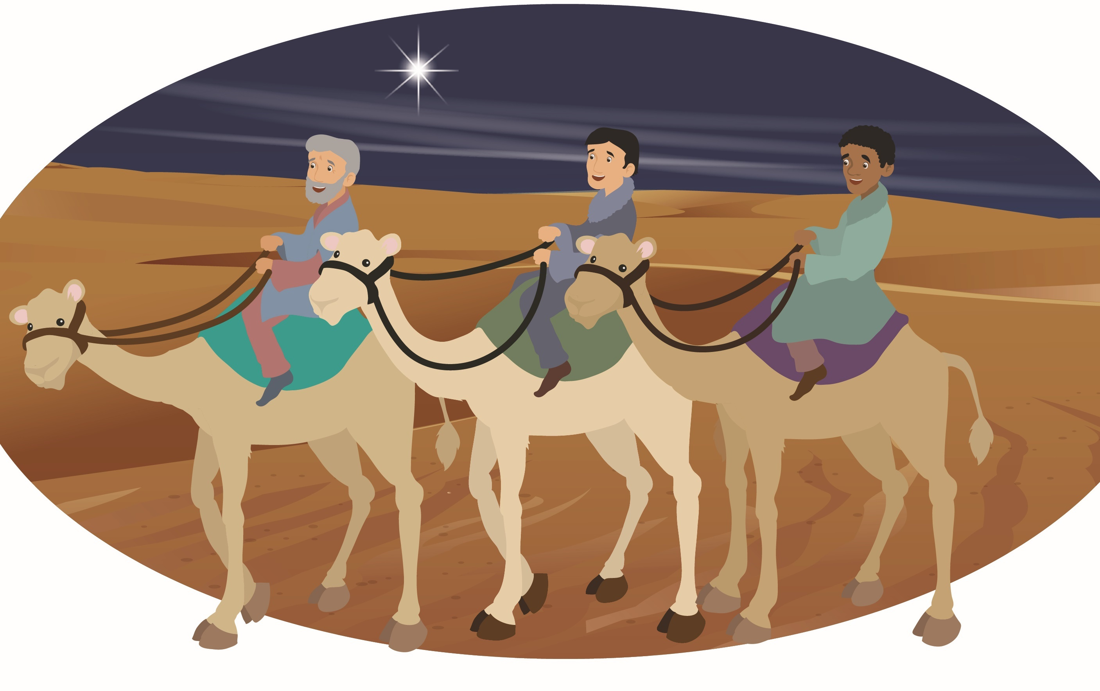
J
O
Y
TO
THE
WORLD
Mary and Joseph immediately said “yes” and thanked him for letting them stay.
That night, Mary gave birth to the baby Jesus.
Not so far away, there were shepherds with flocks of sheep. Angels appeared saying, “The king, saviour of all has been born in a stable in Bethlehem,” and they started to sing.
The shepherds in joy ran to see the baby Jesus. They found him lying in a manger with Mary and Joseph.
Meanwhile, three wise men were gazing at stars and say the brightest star ever seen.
They decided to follow the star.
There were also wise men who were led by a star to the stable where Jesus was born. They gave gold, frankincense, and myrrh as gifts to Jesus.
The word spread and everyone was happy.
© 2020, Sapphire Group Media Publishing.

Slide 10
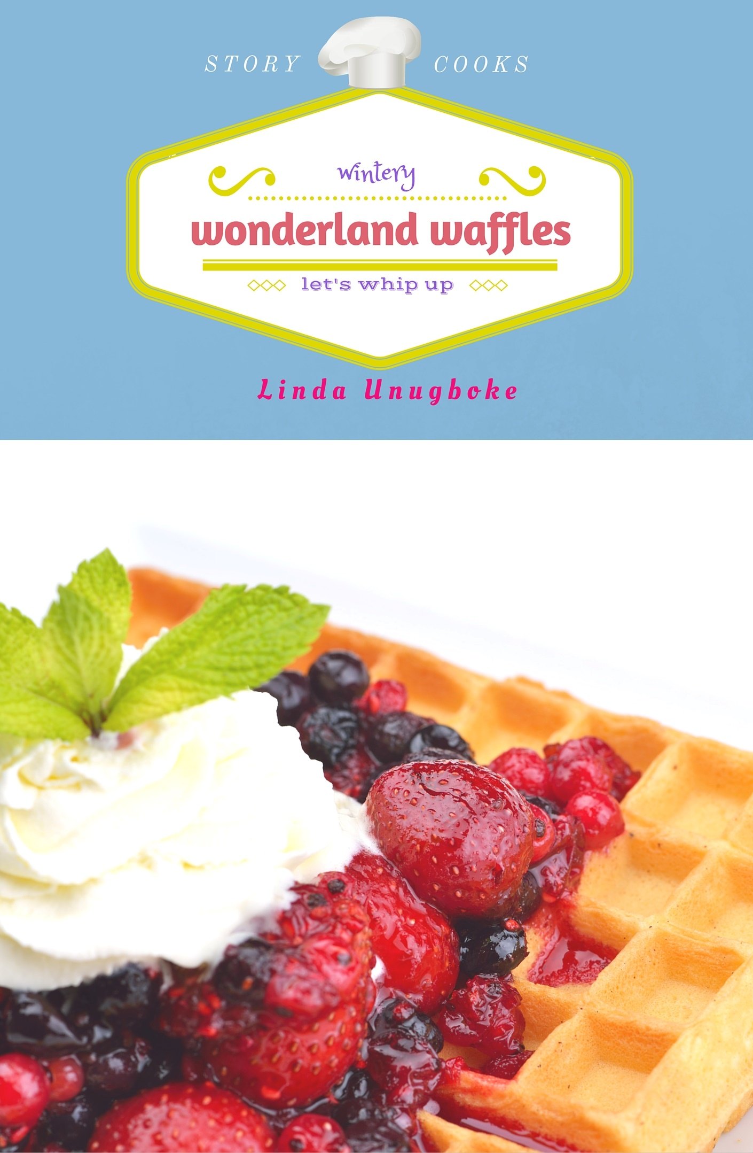
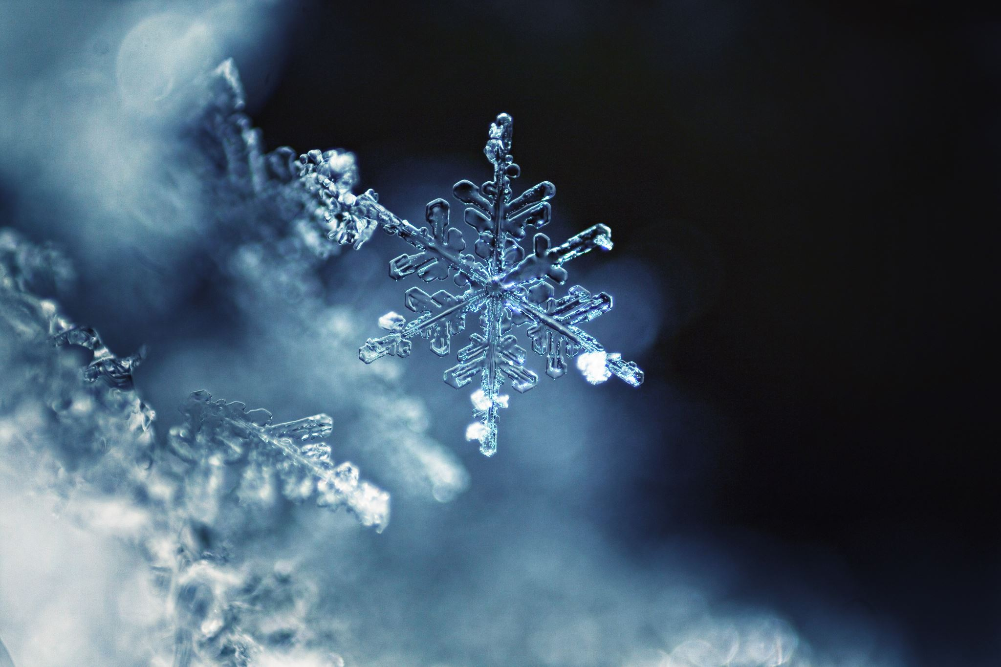
Wonderland Waffles
by Linda Unugboke
Wendy went with her family to the winter wonderland.
While she was there she was hungry and wanted some waffles…
Wendy watched the way the waffles were made.
Flour and sugar were weighed
Eggs were whacked and whisked
Water and milk were whipped
All these ingredients were worked into the waffle mix.
A wiry metal was heated and the waffle mix was wrapped onto it.
The waffle wizzled on the hot wire upon a wooden fire until it was ready. It’s smell whiffing with the wintery wind.
When the waffles were ready, Wendy whizzed whipped cream on it and wolfed it up.
Feel free to try this recipe at home. Share and tag photos with us: @tweenholiday on FB or Instagram or email us:weenholiday@sapphiregroup.uk
© 2020, Sapphire Group Media Publishing.

Slide 11
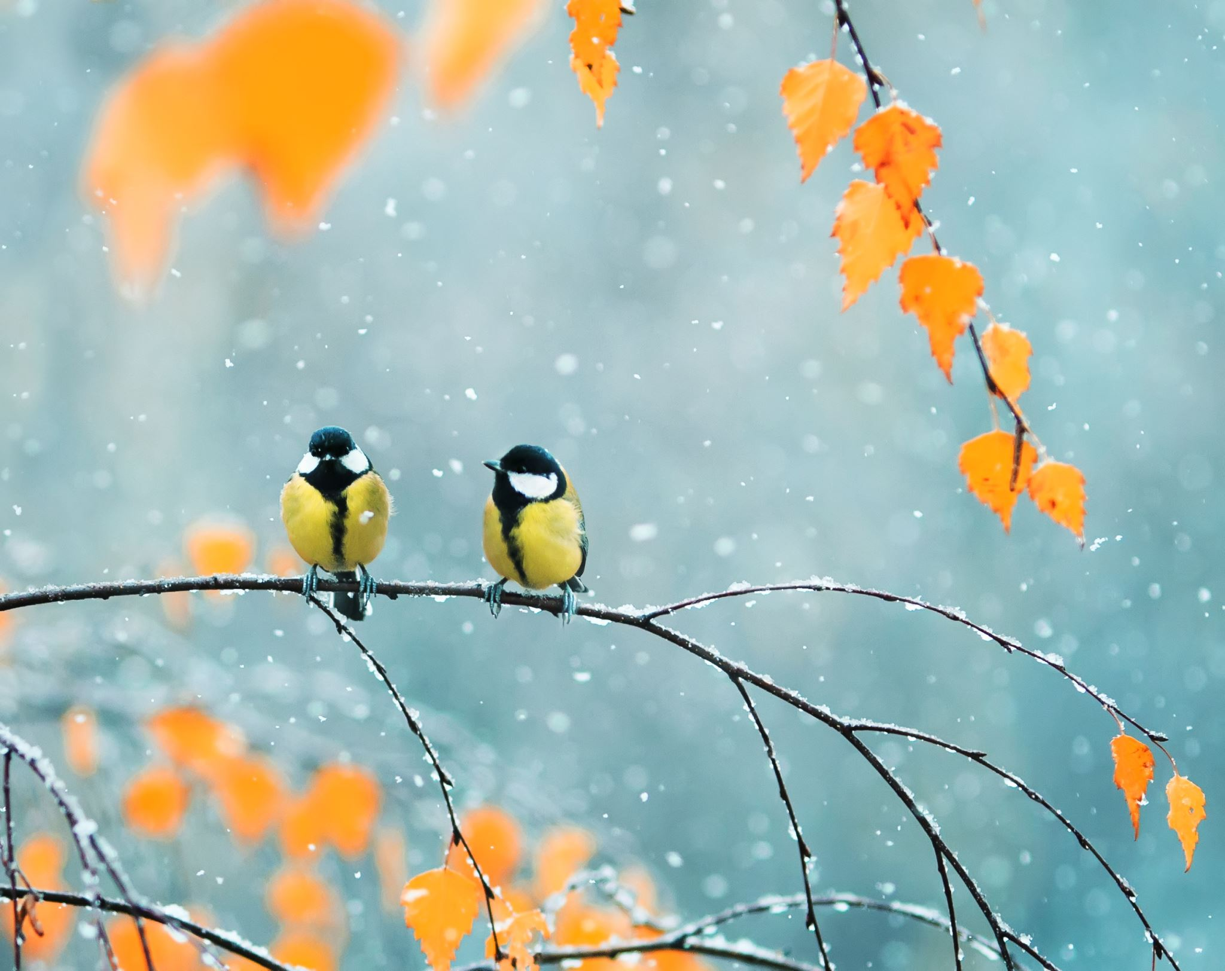
Gratitude Attitude
Take a moment to be grateful for 2020!
Imagine you are one of these two birds chatting.
What can you say you are grateful for?
Write down your thoughts.
© 2020, Sapphire Group Media Publishing.

Slide 12
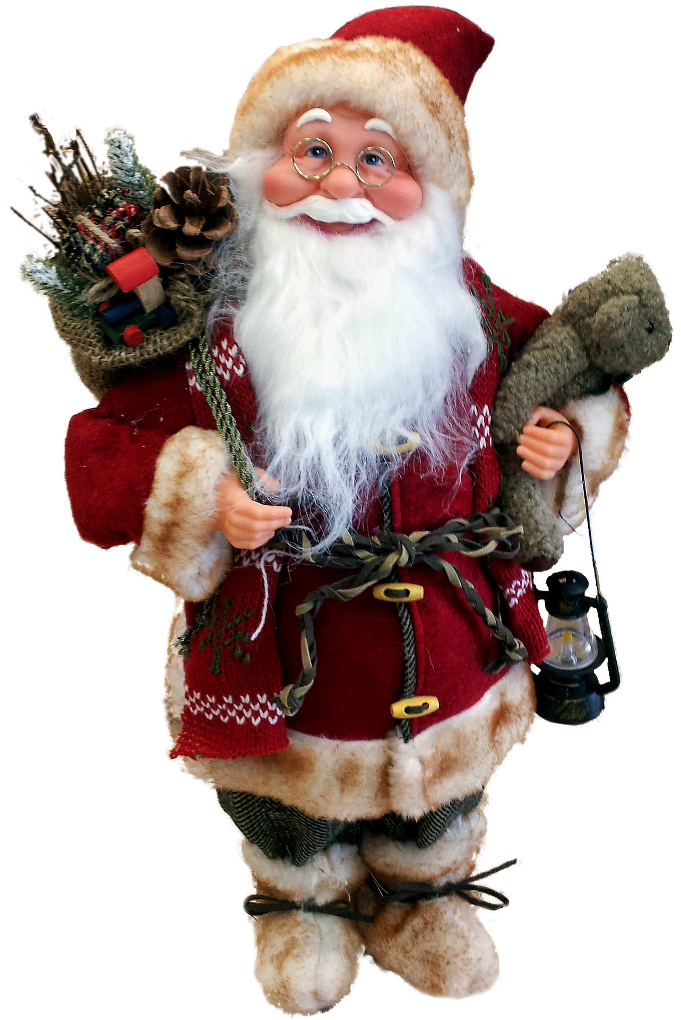
Santa Claus, otherwise known as Saint Nicholas or Kris Kringle, has a long history steeped in Christmas traditions.
The Legend of Santa Claus
Today, he is thought of mainly as the man in red who brings toys to good girls and boys on Christmas Eve. But his story stretches all the way back to the 3rd century, when Saint Nicholas walked the earth and became the patron saint of children.
It is believed that Nicholas was born sometime around 280 A.D. in Patra, near Myra in modern-day Turkey. Much admired for his piety and kindness, St. Nicholas became the subject of many legends. It is said that he gave away all of his inherited wealth and travelled the countryside helping the poor and sick.
One of the best-known St. Nicholas stories is the time he saved three poor sisters from being sold into slavery by their father by providing them with a dowry so that they could be married.
18th-century America’s Santa Claus was not the only St. Nicholas-inspired gift-giver to make an appearance at Christmastime.
There are similar figures and Christmas traditions around the world.
Christkind or Kris Kringle was believed to deliver presents to well-behaved Swiss and German children.
In Scandinavia, a jolly elf named Jultomten was thought to deliver gifts in a sleigh drawn by goats.
English legend explains that Father Christmas visits each home on Christmas Eve to fill children’s stockings with holiday treats.
Père Noël is responsible for filling the shoes of French children
Over the course of many years, Nicholas’ popularity spread, and he became known as the protector of children and sailors.
© 2020, Sapphire Group Media Publishing.

Slide 13
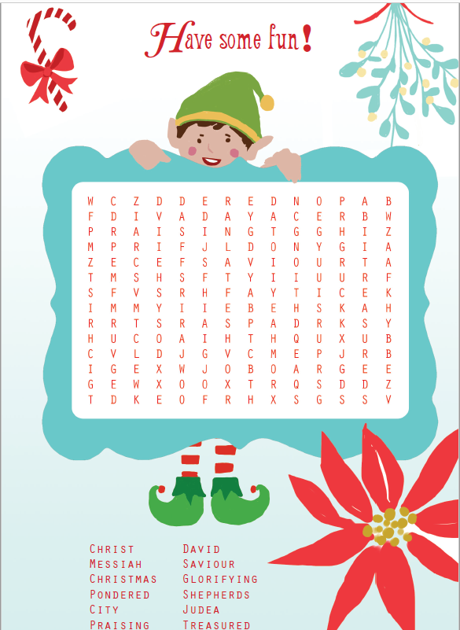
Word Search
Hey!
I’m Amy the elf.
Can you join me in this Christmas themed word search?
You need to find the words below in my mat.
Good luck and…
Merry Christmas! x
Copyright: Tween Holiday Magazine, Issue 5 – Dec 2020

Slide 14
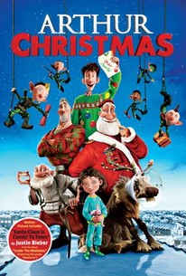
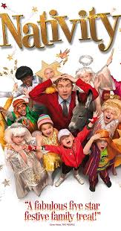
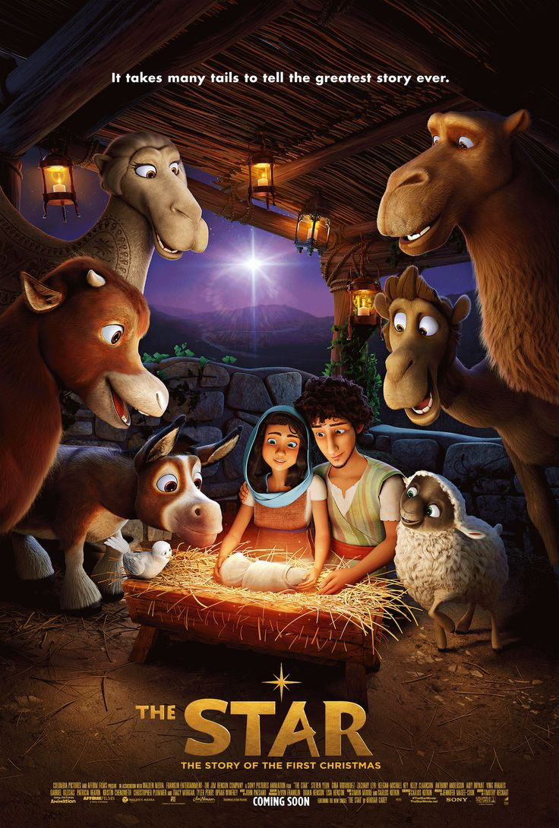

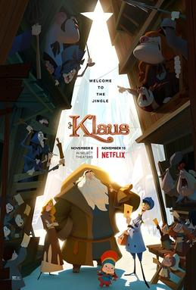

Christmas Holiday Movies
You can see some of these on Netflix.
Tell us your favourite Christmas movies @TweenHoliday on Facebook and Instagram.
The holidays and especially Christmastime is a wonderful time of quiet, where you can spend lots of nights (and days) watching good movies.
Here’s a selection of some of our season’s favourites.
Copyright: Tween Holiday Magazine, Issue 5 – Dec 2020

Slide 15
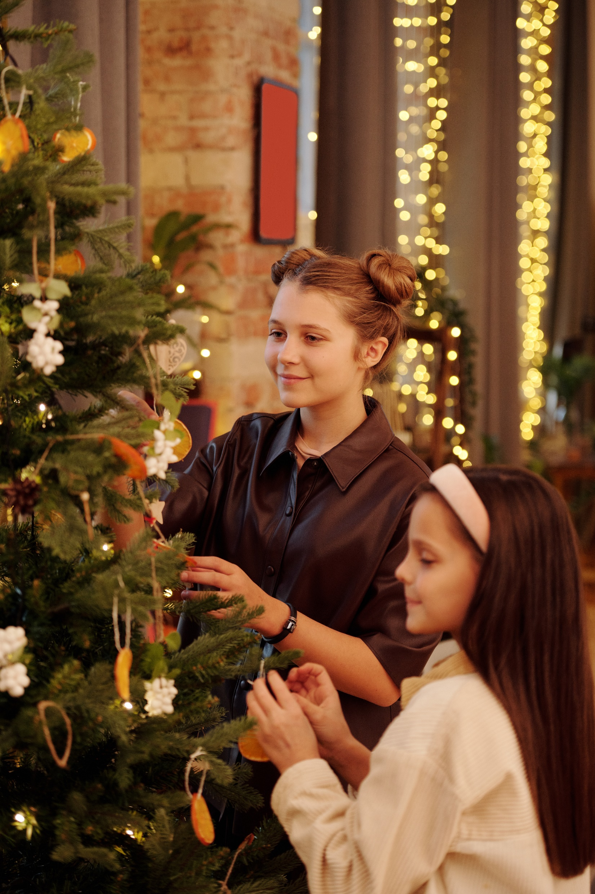
Back cover
Follow and like us (via your parent/carer)
on Instagram/Facebook @tweenholiday
Merry Christmas!
Thanks for all your support this year since we launched issue 1 of our magazine in the summer.
Enjoy your Christmas time and the holidays!
Our next issue will be in the New Year!
Wishing you a Happy 2021!
Email us: tweenholiday@sapphiregroup.uk
Subscribe for free issues:
http://sapphiregroup.uk/subscribe
Copyright: Tween Holiday Magazine, Issue 5 –Dec 2020

Slide 16
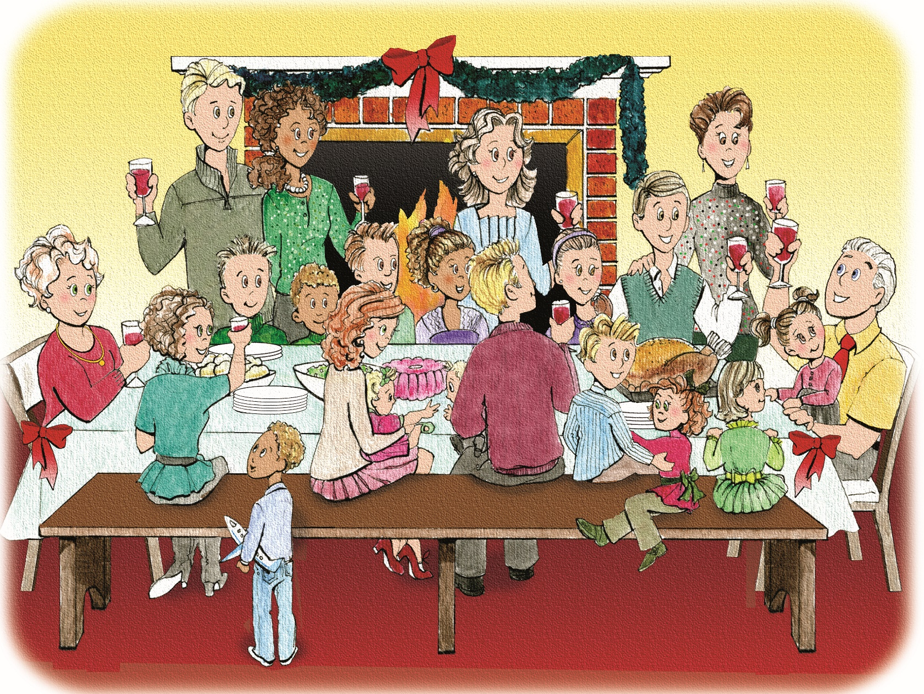
Christmas 2020 – Issue #5
Follow and like us (via your parent/carer)
on Instagram/Facebook @tweenholiday
Email us: tweenholiday@sapphiregroup.uk
Subscribe to more free issues:
http://sapphiregroup.uk/subscribe
© 2020, Sapphire Group Media Publishing.

